Slide 1

Dreamy Toys
Báo cáo đồ án
Lập trình web nâng cao
Tên đồ án:
Nguyễn Khắc Minh Tân
Phát triển:
Giảng viên: Trang Hồng Sơn

Slide 2
Table of contents
Overview
Functions
References
Consequence
Giới thiệu sơ bộ về sản phẩm và thành viên
Tổng quát toàn bộ chức năng có trong sản phẩm
Tài liệu tham khảo
Cải tiến và demo sản phẩm

Slide 3
Overview
Giới thiệu sơ bộ về sản phẩm và thành viên
1

Slide 4
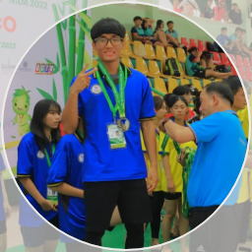
Member
Nguyễn Khắc Minh Tân
Thiết kế và phát triển dự án
2174802010439
2

Slide 5
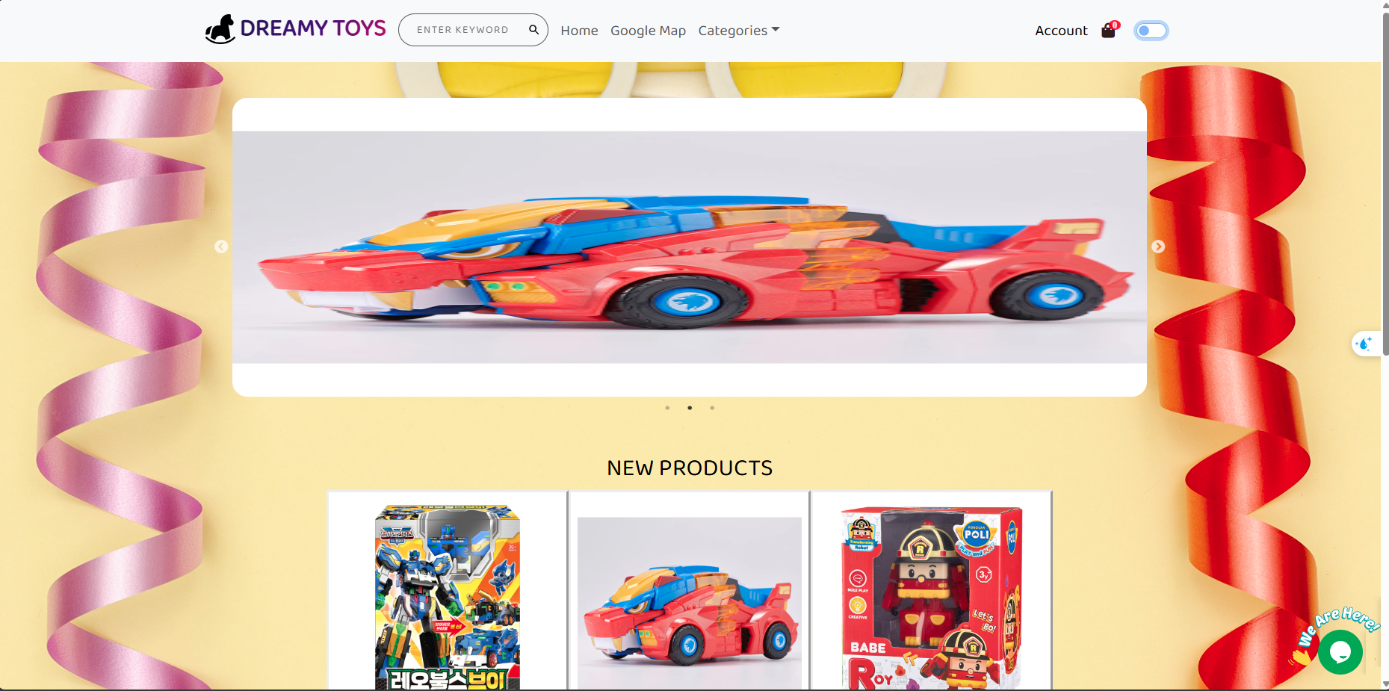
Website
3

Slide 6
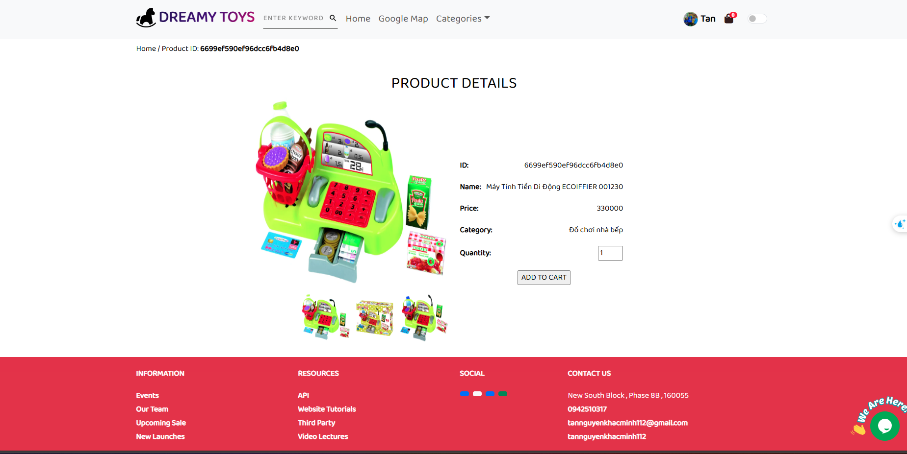
Website
4

Slide 7
Functions
Tổng quát toàn bộ chức năng có trong sản phẩm
5

Slide 8
Tổng kết các chức năng có trong website
27
Chức năng cơ bản
Thêm, xóa, sửa, đăng nhập, đăng kí, gửi email,…
5
Chức năng nhúng
Nhúng chatbot, google map, thông báo,…
5
Chức năng nâng cao
Sắp xếp, lấy lại password, lưu trữ state, tổng kết dữ liệu
6

Slide 9
References
Tài liệu tham khảo
7

Slide 10
References
https://www.w3schools.com/
https://colorlib.com/wp/free-bootstrap-admin-dashboard-templates/
https://freefrontend.com/bootstrap-profiles/
https://getbootstrap.com/docs/5.3/getting-started/introduction/
https://chatgpt.com/
https://www.youtube.com/
https://mdbootstrap.com/docs/standard/extended/product-cards/
8

Slide 11
Consequence
Cải tiến và demo sản phẩm
9

Slide 12
Cải tiến và demo sản phẩm
Reponsive vẫn chưa hoàn chỉnh
Code chưa được mạch lạc
Trang web còn thô và cứng, chưa thực sự dễ dùng
Và còn cần bổ sung rất nhiều tính năng mới có thể được coi là trang web bán hàng
….
10

Slide 13
Social media design services ranking
99%
Instagram
Venus is the second planet from the Sun
80%
Facebook
Despite being red, Mars is a cold place
60%
WhatsApp
Mercury is the closest planet to the Sun
40%
Twitter
Earth is the planet we all live on
20%
LinkedIn
Saturn is a gas giant and has rings
1st
2nd
3rd
4th
5th

Slide 14
The prices of our services
Offline
Online
On + Off
Neptune is the farthest planet from the Sun and the fourth-largest
Venus has a nice name and is the second planet from the Sun
Mercury is the closest planet to the Sun and the smallest one
$2,000
$3,000
$4,500

Slide 15
About our projects
01
Augmented reality
Venus has a beautiful name and is the second planet from the Sun. It’s terribly hot
02
Mobile
Mercury is the closest planet to the Sun and the smallest one in the Solar System
03
Internet
Jupiter is a gas giant and the biggest planet in the Solar System
04
Press
Saturn is the ringed planet. It’s a gas giant, composed of hydrogen and helium

Slide 16
Creative project process
Brainstorm
Plan
Saturn is the ringed planet and also a gas giant
Neptune is the farthest planet from the Sun
50%
17%
85%
30%
5%
Idea
Analysis
Start
Venus has a nice name, but it’s terribly hot
Mercury is the closest planet to the Sun
Earth is the beautiful planet we live on

Slide 17
Project process
Start
Design
Earth is the third planet from the Sun. It is the planet we all live on
Venus has a beautiful name and is the second planet from the Sun
02
04
01
03
Research
Develop
Neptune is the farthest planet from the Sun and the fourth-largest
Saturn is one of the biggest planets and has several rings

Slide 18
Concept design process
A
The creative update
Venus is the second planet from the Sun
B
Molding concept as per client
Despite being red, Mars is actually a cold place
C
Presenting the first concepts
Mercury is the closest planet to the Sun
D
Time to revise
Jupiter is the biggest planet of them all
E
We’re ready!
Saturn is a gas giant and has rings

Slide 19
Digital product value chain
Develop
Jupiter is the biggest planet in the Solar System
Analyze
Saturn is a gas giant and the ringed planet
Digital product
Neptune is the farthest planet from the Sun and the fourth-largest
Identify
The Sun is the star at the center of the Solar System
100%
Advertise
Despite being red, Mars is actually a cold place

Slide 20
The best projects of the agency
210
200
170
175
120
90
Project 1
Project 2
Project 3
Project 4
Project 5
Project 6
Neptune is the farthest planet from the Sun
Jupiter is a gas giant and the biggest planet
Saturn is a gas giant and has several rings
Mercury is the closest planet from the Sun
Despite being red, Mars is a cold place
Earth is the third planet from the Sun

Slide 21
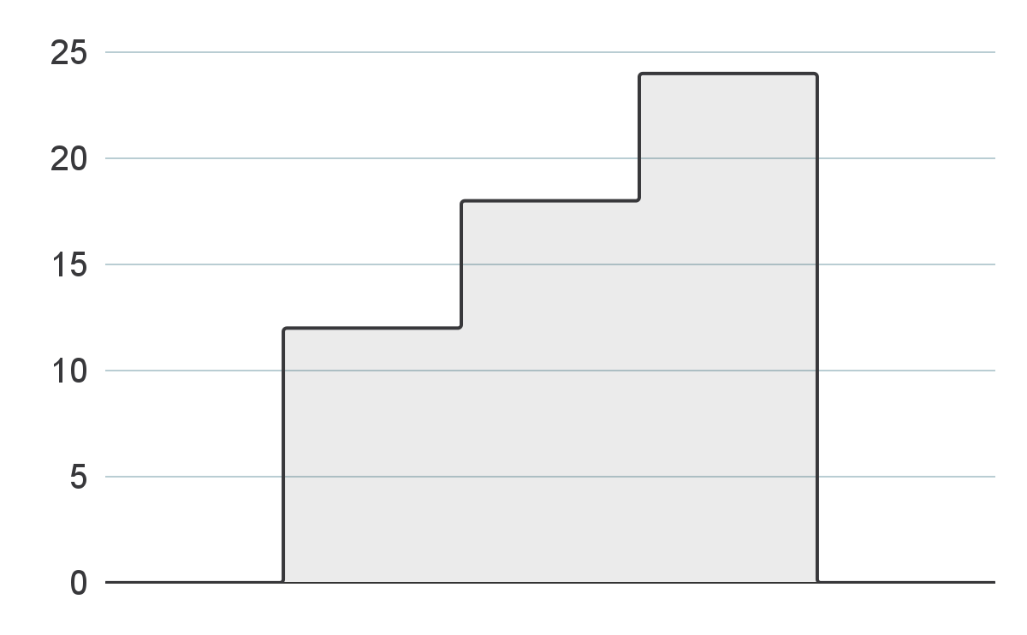
Finished projects
12
Digital & press
Mercury is the closest planet to the Sun and the smallest one
18
Mobile & desktop
Saturn is the ringed planet and also a gas giant
24
VR & panoramic images
Venus has a beautiful name and is the second planet from the Sun
Follow the link in the graph to modify its data and then paste the new one here. For more info, click here

Slide 22
What they say about us
85%
42%
65%
Creative
Fast
Reliable
Neptune is the farthest planet from the Sun and the fourth-largest
Saturn is a gas giant and is mostly composed of hydrogen and helium
Despite being red, Mars is a very cold place, not hot at all

Slide 23
How to have good ideas
A
B
C
D
Plan
Create
Publish
Evaluate
Neptune is the farthest planet from the Sun and the fourth-largest
Earth is the third planet from the Sun. It is the planet we all live on
Venus has a beautiful name and is the second planet from the Sun
Saturn is one of the biggest planets and also a gas giant

Slide 24
Our values
1
Imagination
Mercury is the closest planet to the Sun and the smallest one
2
Simplicity
Saturn is the ringed planet. It’s composed of hydrogen and helium
3
Integrity
Venus has a beautiful name and is the second planet from the Sun

Slide 25
All time statistics
250
324
97
1,460
2,835
Clients
Days
Projects
Letters
Calls
Neptune is the farthest planet from the Sun
Jupiter is a gas giant and the biggest planet
Saturn is a gas giant and has several rings
Mercury is the closest planet to the Sun
Despite being red, Mars is actually a cold place

Slide 26
About creative professionals
45%
Graphic designers
Mercury is the closest planet to the Sun and the smallest in the Solar System
55%
Product designers
Venus has a beautiful name and is the second planet from the Sun

Slide 27
Profile of our designers
Dorothee, Art Director
Jupiter is a gas giant and the biggest planet in the Solar System. It's the fourth-brightest object in the night sky. It was named after the Roman god of the skies and lightning
Her skills
Animation
90%
Illustration
80%
Photo edition
70%

Slide 28
Design agency team
Marketers
Saturn is a gas giant and has several rings
Copywriters
Sellers
Jupiter is a gas giant and the biggest planet
Mercury is the closest planet to the Sun
12
10
6
Designers
IT
Neptune is the farthest planet from the Sun
Despite being red, Mars is actually a cold place
15
8

Slide 29
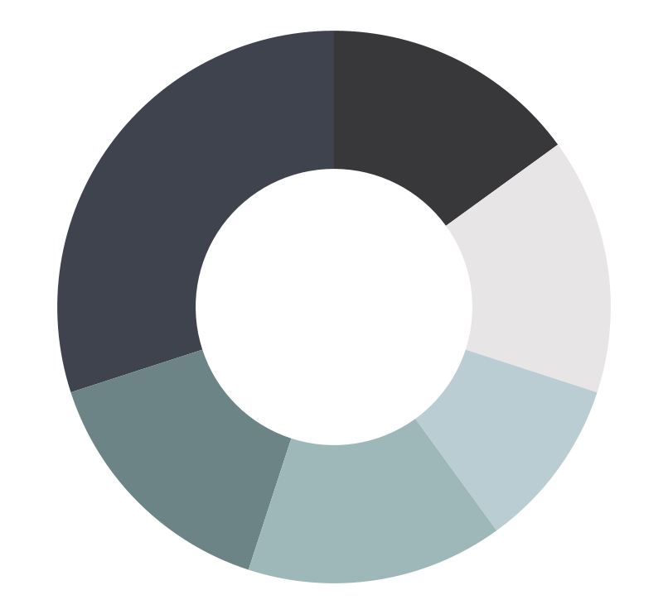
More about the team
Designers
30%
15%
Marketing
Neptune is the farthest planet
Mercury is a small planet
Copywriters
15%
15%
Research
Mars is a cold place
Saturn is a gas giant planet
Animators
15%
10%
Sales
Follow the link in the graph to modify its data and then paste the new one here. For more info, click here
Earth is where we live on
Venus has a beautiful name

Slide 30
Our team's favorite software
50%
25%
65%
35%
85%
Neptune
Jupiter
Saturn
Mercury
Mars
Neptune is the farthest planet from the Sun
Jupiter is a gas giant and the biggest planet
Saturn is a gas giant and has several rings
Mercury is the closest planet to the Sun
Despite being red, Mars is actually a cold place

Slide 31
About design software
Animation
Mercury is the closest planet to the Sun and the smallest one
Web design
Saturn is the ringed planet. It’s composed of hydrogen and helium
Editorial design
Venus has a beautiful name and is the second planet from the Sun

Slide 32
Creative project schedule
 | March | April | May | June
Process 1 | Mercury is the closest planet to the Sun and the smallest one
Process 2 | Venus has a beautiful name
Process 3 |  | Despite being red, Mars is actually a cold place. It's full of iron oxide dust, which gives the planet its reddish cast
Process 4 |  |  | Saturn has several rings
Process 5 |  |  |  | Neptune is the farthest planet
Copy
Neptune is the farthest planet from the Sun
Design
It’s a gas giant and the biggest planet

Slide 33
Design team schedule
Planning
01/07
Earth is the third planet from the Sun and where we live on
Creating
10/07
Venus has a beautiful name and is the second planet from the Sun
Publishing
25/07
Jupiter is a gas giant and the biggest planet of the Solar System
Reporting
05/08
Saturn is one of the four gas giants and the ringed planet

Slide 34
Creation roadmap
Ideation
Concept
Testing
Release
Neptune is the farthest planet
Earth is where we live on
Venus has a beautiful name
Mercury is the smallest planet
5 days
15 days
10 days
20 days
10 days
20 days
15 days
5 days
Sounding
Design
Analysis
Launch
Jupiter is the biggest planet of all
Pluto is considered a dwarf planet
Mars is actually a very cold place
Uranus is the coldest planet

Slide 35
Design team timeline
2 - 5 days
3 - 7 days
2 - 7 days
2 - 4 days
Project brief
Initial draft
Collaboration
Print production
Neptune is the farthest planet from the Sun and the fourth-largest
Earth is the third planet from the Sun. It is the planet we all live on
Saturn is one of the biggest planets. It is a gas giant
Venus has a beautiful name and is the second planet from the Sun

Slide 36
Design project phases
100%
80%
60%
Launch
40%
Delivery
Earth is the third planet from the Sun
20%
Concept
Despite being red, Mars is a cold place
0%
Sketch
Mercury is the closest planet to the Sun
Research
Saturn is a gas giant and has several rings
Meet
Jupiter is a gas giant and the biggest planet
Neptune is the farthest planet from the Sun

Slide 37
The principle of balance in our projects
Hierarchy
Proximity
Variety
Contrast
Similarity
Neptune is the farthest planet
Jupiter is the biggest planet
Mercury is the smallest planet
Venus has a beautiful name
Mars is actually a very cold place

Slide 38
Creative project phases
Brainstorm
Build it
Neptune is the farthest planet
Mercury is the smallest planet
Hypothesis
Feedback
Venus has a beautiful name
Mars is actually a very cold place
Experiment
Our process
Saturn is a gas giant with rings
Jupiter is the biggest planet

Slide 39
Instructions for use
In order to use this template, you must credit Slidesgo in your final presentation.
You are allowed to:
- Modify this template.
- Use it for both personal and commercial projects.
You are not allowed to:
- Sublicense, sell or rent any of Slidesgo Content (or a modified version of Slidesgo Content).
- Distribute Slidesgo Content unless it has been expressly authorized by Slidesgo.
- Include Slidesgo Content in an online or offline database or file.
- Offer Slidesgo templates (or modified versions of Slidesgo templates) for download.
- Acquire the copyright of Slidesgo Content.
For more information about editing slides, please read our FAQs or visit Slidesgo School:
https://slidesgo.com/faqs and https://slidesgo.com/slidesgo-school

Slide 40
Instructions for use (premium users)
In order to use this template, you must be a Premium user on Slidesgo.
You are allowed to:
Modify this template.
Use it for both personal and commercial purposes.
Hide or delete the “Thanks” slide and the mention to Slidesgo in the credits.
Share this template in an editable format with people who are not part of your team.
You are not allowed to:
Sublicense, sell or rent this Slidesgo Template (or a modified version of this Slidesgo Template).
Distribute this Slidesgo Template (or a modified version of this Slidesgo Template) or include it in a database or in any other product or service that offers downloadable images, icons or presentations that may be subject to distribution or resale.
Use any of the elements that are part of this Slidesgo Template in an isolated and separated way from this Template.
Register any of the elements that are part of this template as a trademark or logo, or register it as a work in an intellectual property registry or similar.
For more information about editing slides, please read our FAQs or visit Slidesgo School:
https://slidesgo.com/faqs and https://slidesgo.com/slidesgo-school

Slide 41
Infographics
You can add and edit some infographics to your presentation to present your data in a visual way.
Choose your favourite infographic and insert it in your presentation using Ctrl C + Ctrl V or Cmd C + Cmd V in Mac.
Select one of the parts and ungroup it by right-clicking and choosing “Ungroup”.
Change the color by clicking on the paint bucket.
Then resize the element by clicking and dragging one of the square-shaped points of its bounding box (the cursor should look like a double-headed arrow). Remember to hold Shift while dragging to keep the proportions.
Group the elements again by selecting them, right-clicking and choosing “Group”.
Repeat the steps above with the other parts and when you’re done editing, copy the end result and paste it into your presentation.
Remember to choose the “Keep source formatting” option so that it keeps the design. For more info, please visit Slidesgo School.

